Slide 1
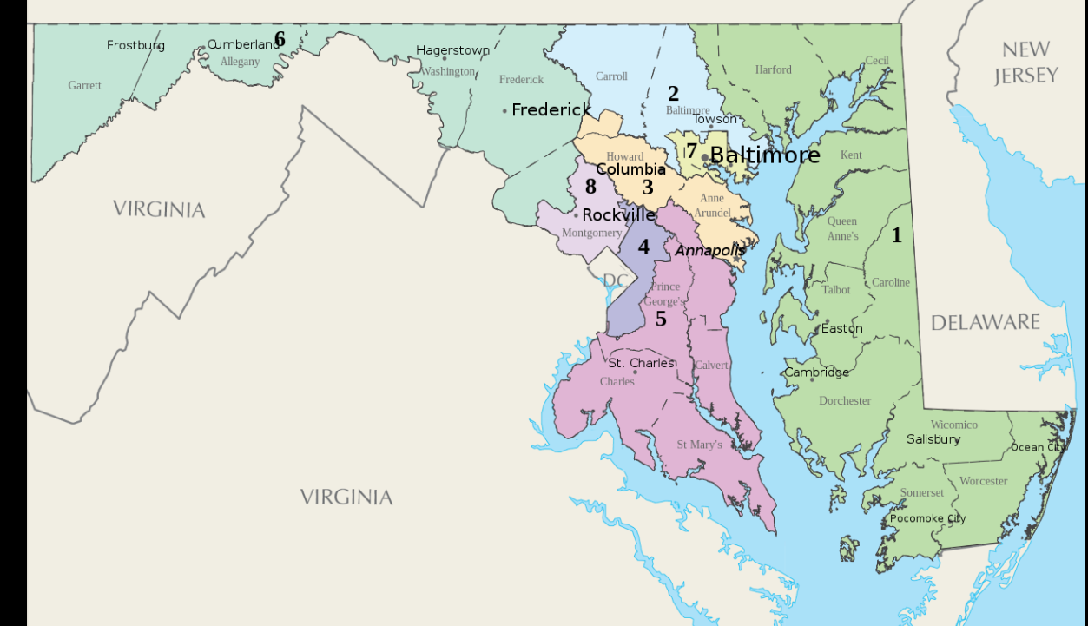
New Congressional Map

Slide 2
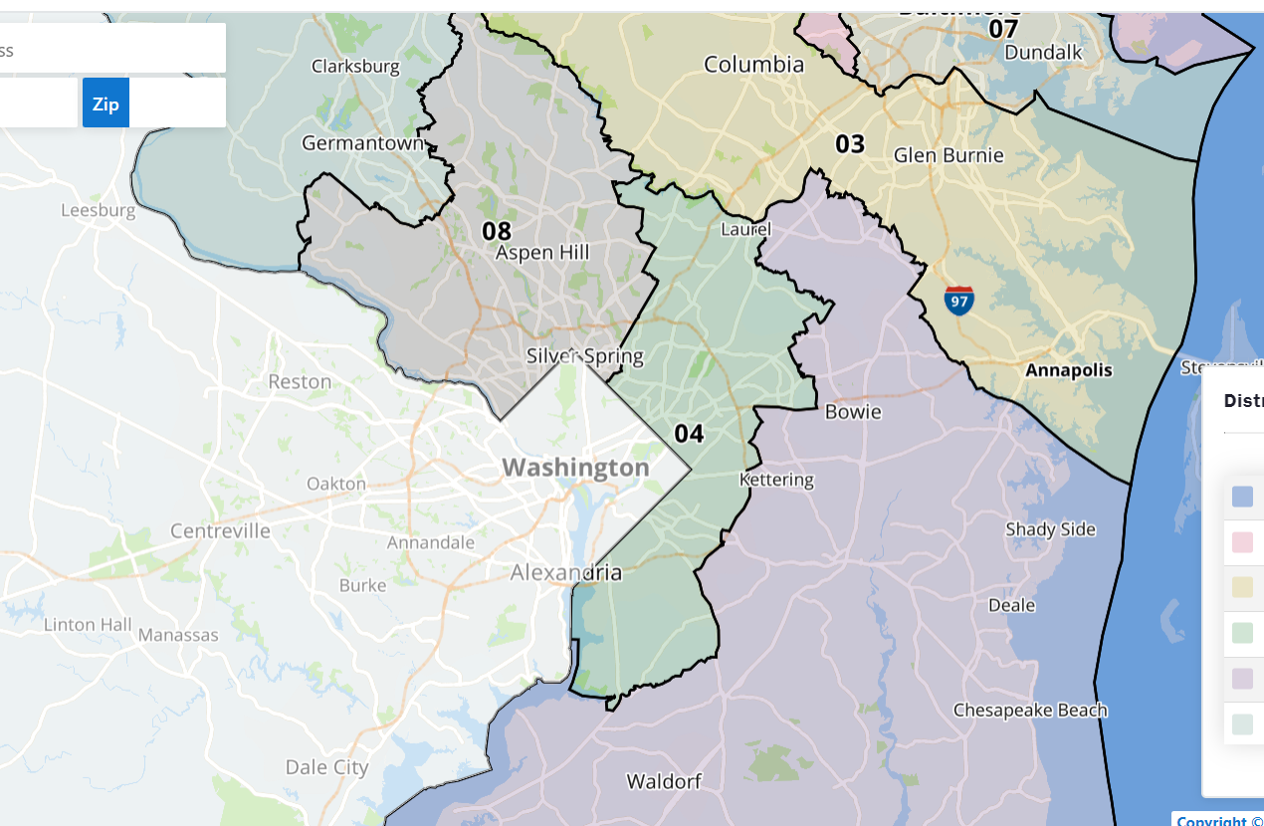
Close up of new congressional district 4

Slide 3
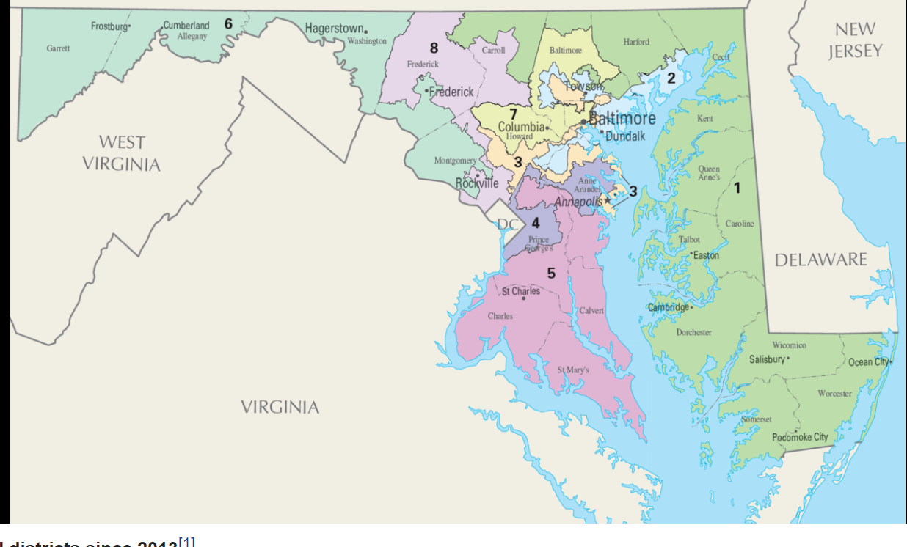
Old Congressional Districts

